Slide 1
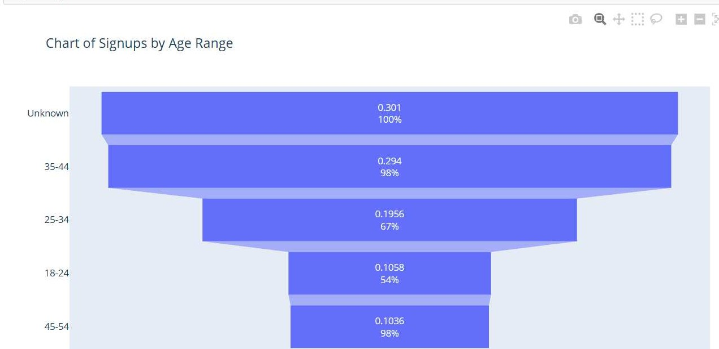
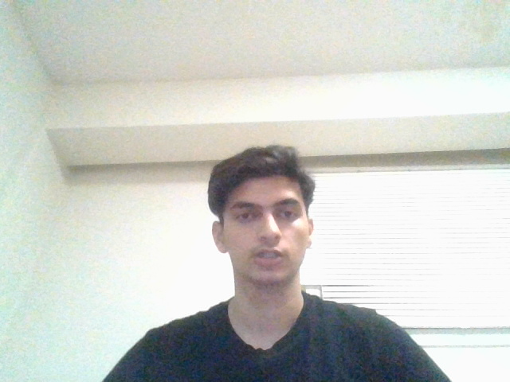
apply youtube adds for 45-54 age group
Age Distribution Insights
Age-Driven Funnel Analysis

Slide 2
Thanks You
Mandeep Toor
mandeeptoor014@gmail.com

